Slide 1
Welcome

Slide 2
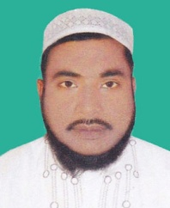
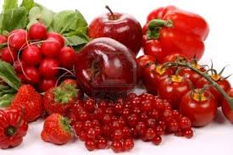
Identity
Presentator
Md.Mokbul Hussin
Assistant teacher.
Sipan Dhakhil Madrahs
Gafar gaon,Mymensingh.
Unit- Five

Slide 3
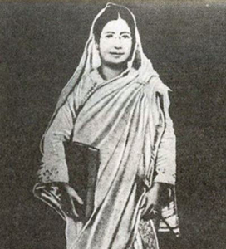
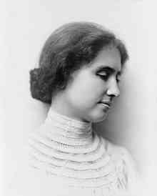
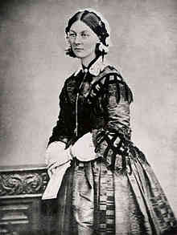
Look at the pictures
Great women to remember.

Slide 4
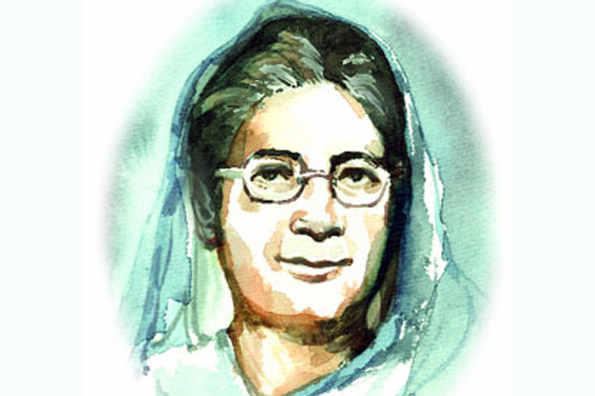
Today’s lesson is Begum Rokeya

Slide 5
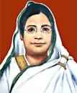
Name:Begum Rokeya
Born: 1880 AD. Birth place: Pairabondh,Rangpur
Father :
Jahiruddin M.Abu Ali Haider Saber
Married :
1896
Husband :
Khan Bahadur Sakhawat Hossain
Occupation : Writer and Social worker
Death: 9 December,1932.

Slide 6
Evaluation
1. Where was Begum Rokeya born ?
2. What was her husband ?
3. What are some of Begum Rokeya’s important writing ?

Slide 7
Home work
You will write a paragraph about “Begum Rokeya”
within 200 words.

Slide 8
Thank You everybody

